Slide 1
Scalar fields

Slide 2
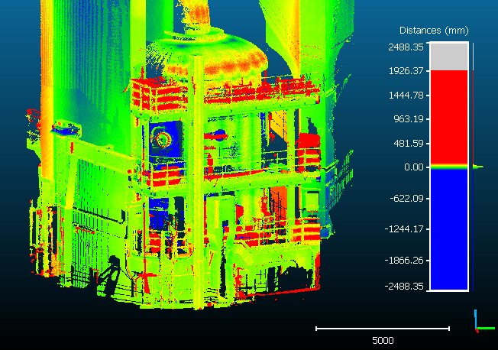
Scalar fields
One value per point …
… any value (distance, intensity, density, roughness, confidance, curvature, temperature, time, etc.)
… can be (dynamicallly) colored

Slide 3

Scalar fields
Values can be:
  composed (+,-,/,x) and transformed (cos, log, etc.)
  filtered (smoothed, gradient, etc.)
  imported from point coordinates (X, Y ou Z) or the opposite way
  converted to RGB (or merged with existing colors)
Statistics computation (histogram, average, std. dev.)
A cloud can be modified based on these values
  Segmentation inside a given range (Edit > SF > Filter by value)
  Subsampling
Values can be exported to an ASCII file (CSV)
  → Excel, Matlab, etc.

Slide 4
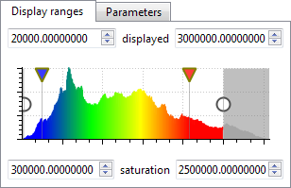
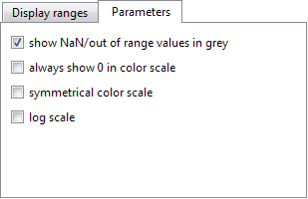
Scalar fields
Dynamic and customizable coloration
  dedicated editor (see the properties of the highlighted entity)
  real-time update of the point colors
Unlimited number of scalar fields per cloud

Slide 5
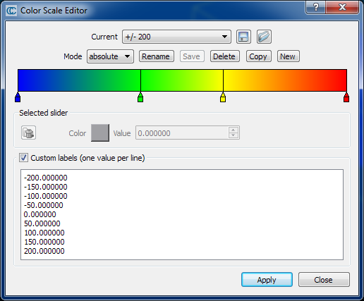
Color scales
« Color Scale Editor »: to edit or create custom color scales
import/export to a dedicated XML file
color ramps are also saved in BIN files

